Slide 1
AI MINI PROJECT
ON
EMPLOYEE TURNOVER PREDICTION
GROUP MEMBERS:
1]AYUSH NAIK
2]RAKESH MALI
3]MITALI ROTE

Slide 2
PROBLEM STATEMENT DEFINATION
Employee turnover is one of the most significant problems an organization can encounter throughout its lifecycle, as it is difficult to predict and often introduces noticeable voids in an organization’s skilled workforce .
The term Employee turnover refers to the total number of workers who leave a company over a certain time period.

Slide 3
Types of Turnover
Voluntary
Involuntary

Slide 4
1] Voluntary Turnover:-
This type of turnover is when an employee decides to voluntarily leave the organization.
It is the employee’s choice to disassociate from the organization, without pressure from any external forces.
2] Involuntary Turnover:-
This type of turnover is when an employee is fired, or asked to leave the organization due to various factors (which cannot always be pinpointed).

Slide 5
METHODOLOGY
Decision Tree
Decision tree is a supervised method which builds classification or regression models in a tree-like structure.
The decision tree method is: (1) conceptually easy yet powerful ; (2) intuitive for interpretation; (3) capable of handling missing values and mixed features ; and (4) able to select variables automatically .

Slide 6
Logistic Regression
Logistic Regression (LR) is a traditional classification algorithm involving linear discriminants, as originally proposed in 1958 by Cox .
The goal of any type of regression is to predict an outcome using one or more other factors.
In basic terms, Logistic Regression is a form of regression that is used when the outcome you're trying to predict is either a 1 or 0.
This is the case for predicting turnover; people either quit or they don't.

Slide 7
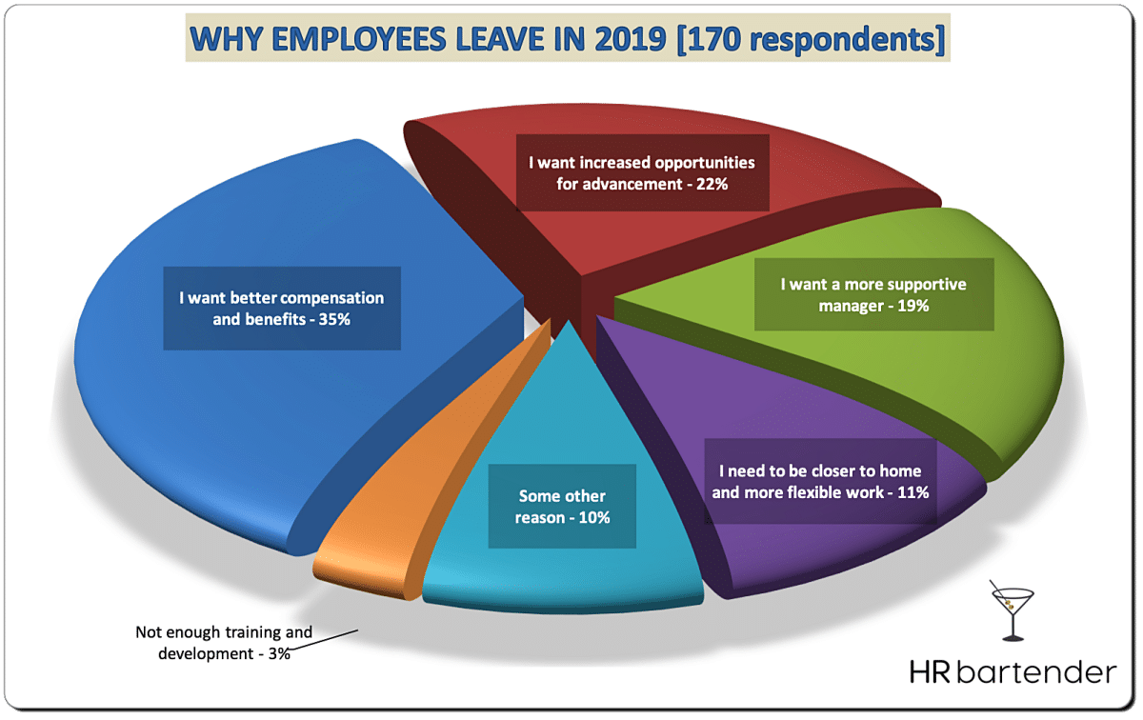
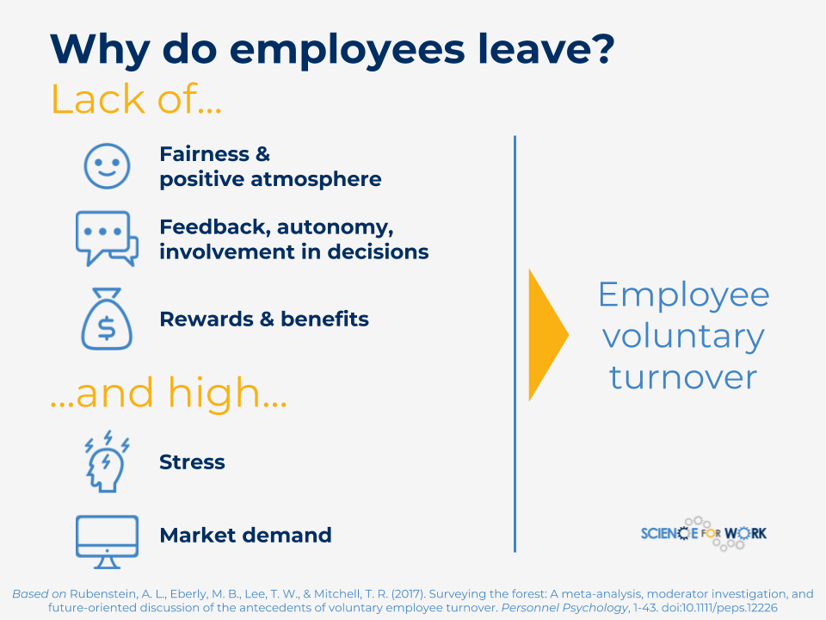

Slide 8
ADVANTAGES
Turnover Can Create Talent Success
On the other hand, if you are consistently seeing B or C players leave on their own accord, it may be a sign that your performance-driven culture or compensation plan is accomplishing its intended mission: retaining and engaging the best of the best.
Improves Talent Potential
Employee turnover can sometimes be an indicator of moving towards success at an organization. When an organization fosters continual growth, there’s a give and take.

Slide 9
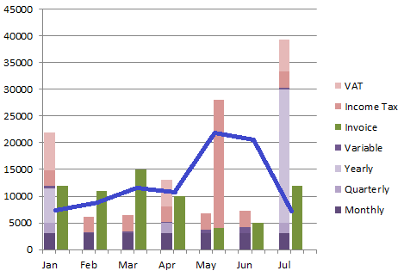
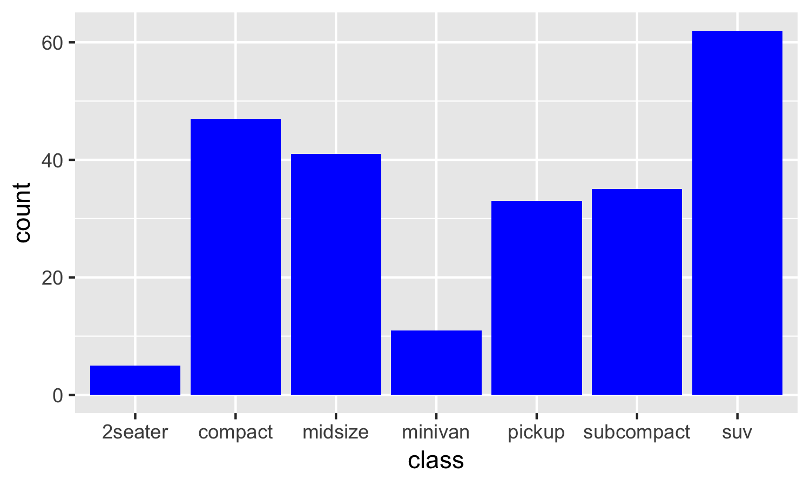

Slide 10
DISADVANTAGES
The cost of high staff turnover
Replacing staff is an expensive process for businesses. According to an Oxford Economics study from 2014, replacing an employee costs an average of £30,614 per employee.
2. Quality and productivity
With gaps in staffing and new staff needing time to learn, the quality of your products or services can suffer.or vice versa.
3. Morale
When employees are leaving your organisation, this can cause other staff members to feel demoralised and even become more likely to leave themselves.

Slide 11
CONCLUSION
Employee turnover has been identified as a pivotal factor to curb the growth of organizations.
In addition to statistical analysis, a number of data mining techniques were introduced and used in this study, including data scaling, parameter searching and cross validation.
The numerical experiment results indicate that for small HR datasets, the key is to try different algorithms as Hughes phenomenon may result in overoptimistic results.

